Slide 1

Git, GitHub and BitBucket

Slide 2
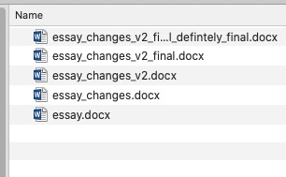
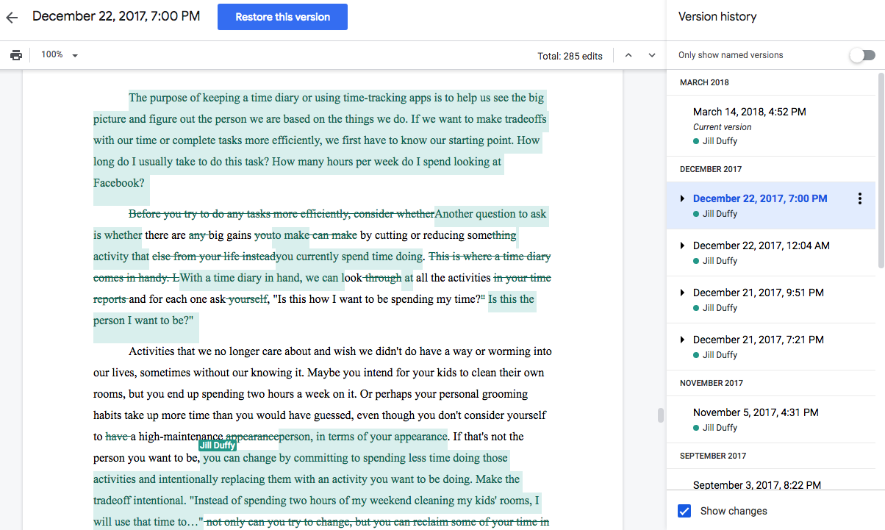
Git is a protocol for version control
Version control
No version control

Slide 3
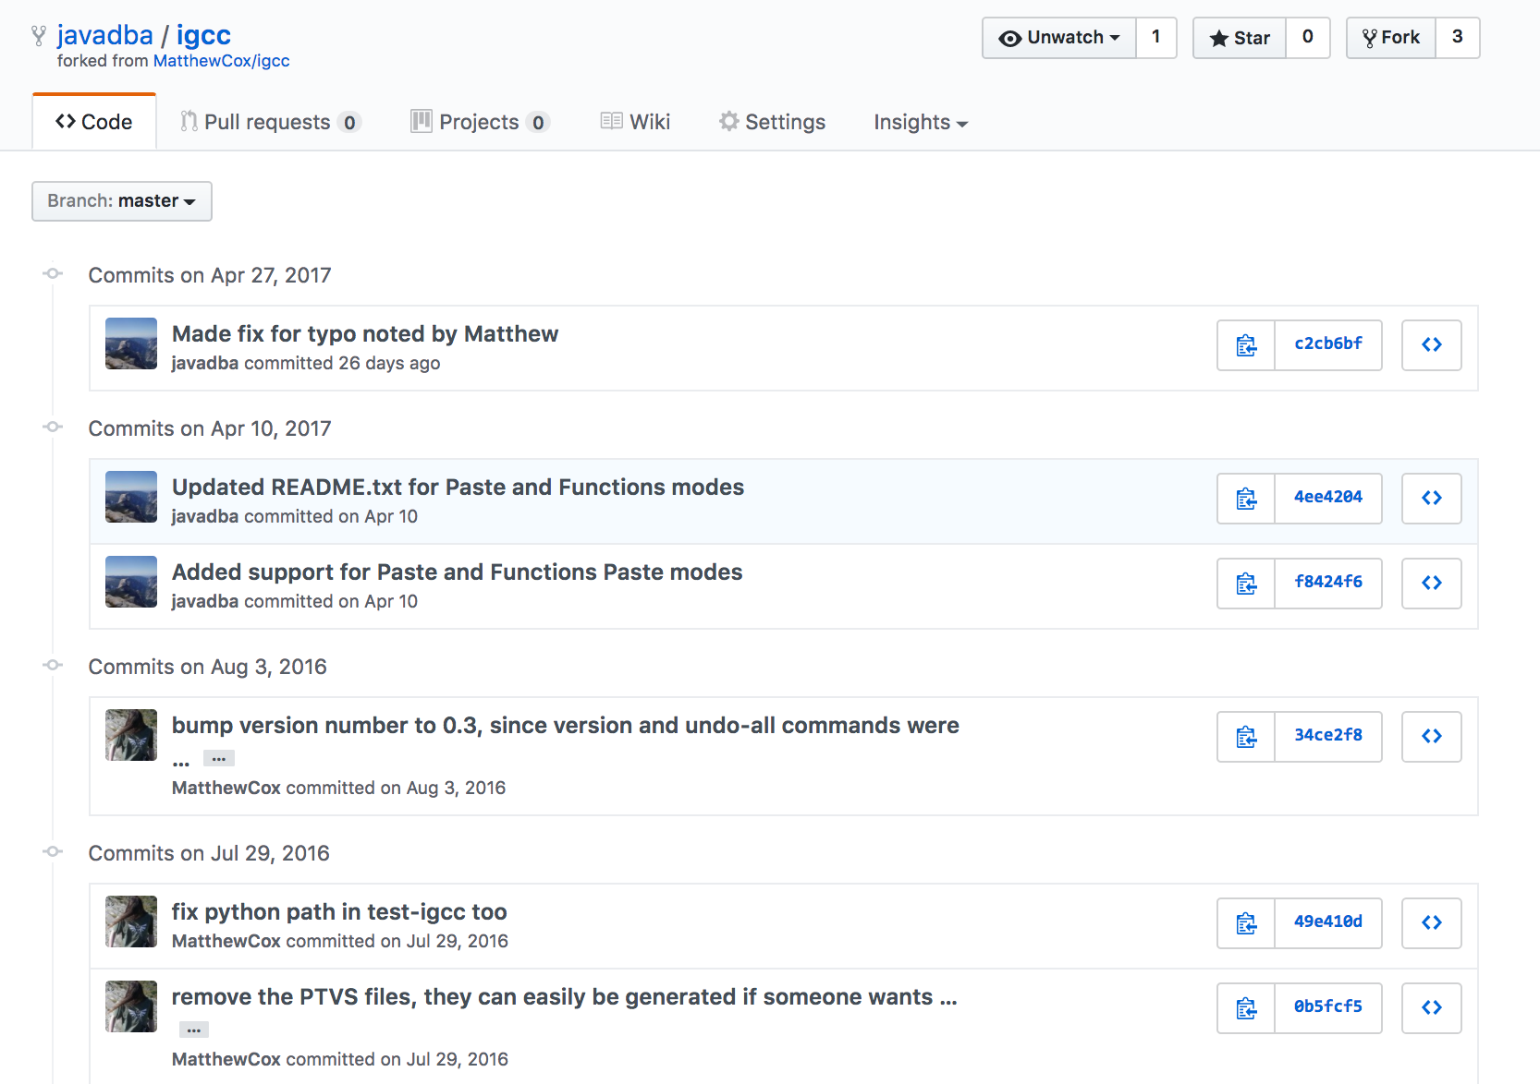
Workflow with Git

